Slide 1
Welcome to Britain!
Plan of the lesson:
1. Check up your homework.
2. Slide-show “Welcome to Britain”.
3. Word exercises.
4. Listening.
5. Quiz.
6. Reading.
7. Word exercises.
8. Dialogue.
9. Conclusion. Homework.

Slide 2
London,
Buckingham Palace,
Queen Elizabeth II,
Big Ben,
Houses of Parliament,
Baker Street,
Sherlock Holmes,
Arthur Conan Doyle,
Scotland,
Wales,
Eisteddfod,
Loch Ness,
England,
Castle,
Giant’s Causeway,
Northern Ireland,
Belfast

Slide 3
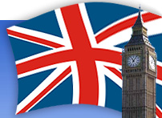
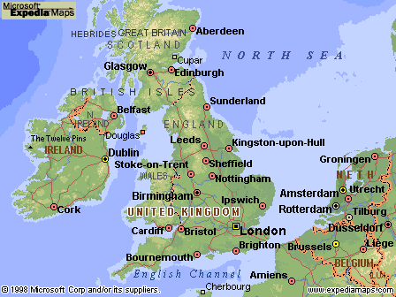
Welcome to Britain!

Slide 4
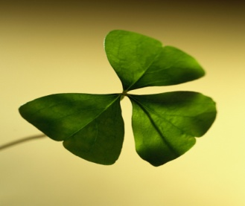
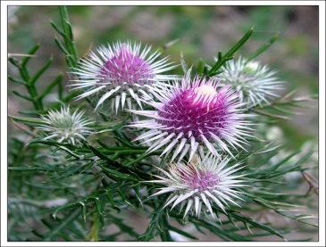
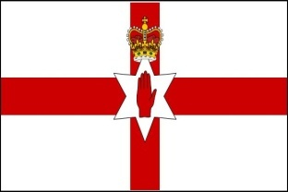
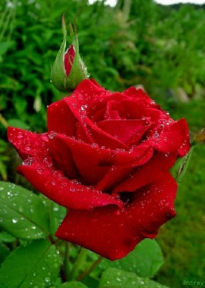
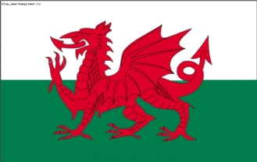
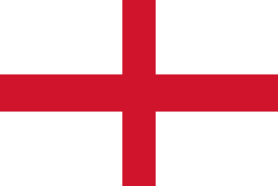
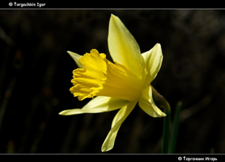
The Symbols and National Flags of the Countries
shamrock
thistle
red rose
daffodil

Slide 5
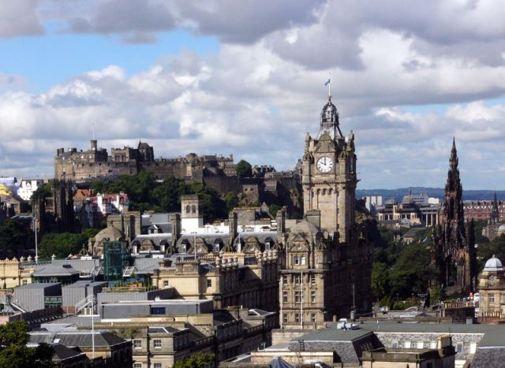
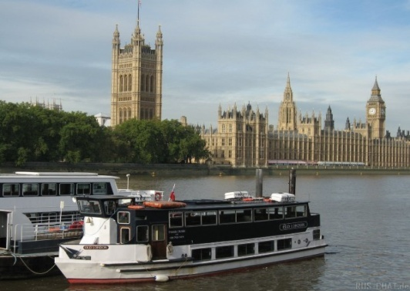
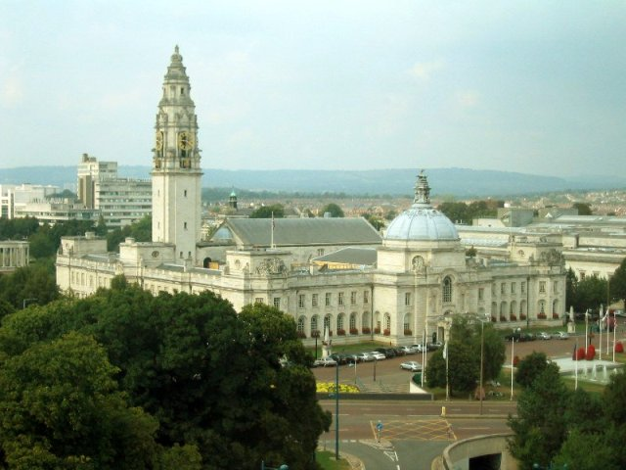
The Capitals
Edinburgh
Belfast
London
Cardiff

Slide 6
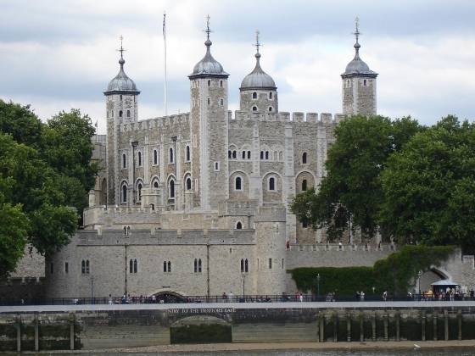
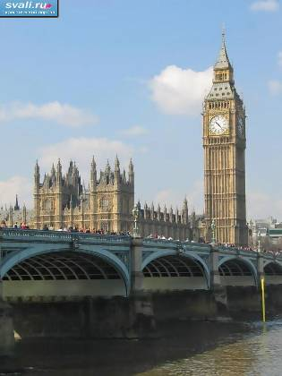
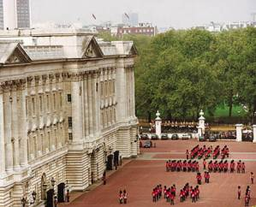
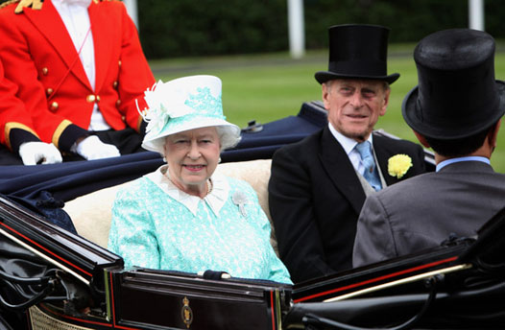
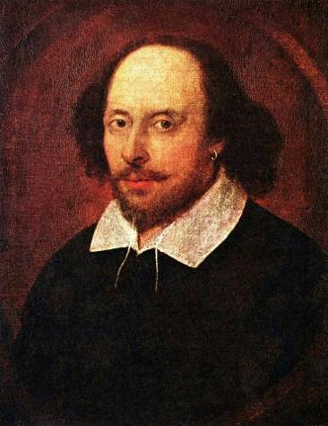
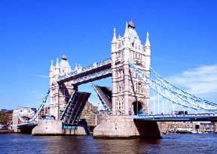
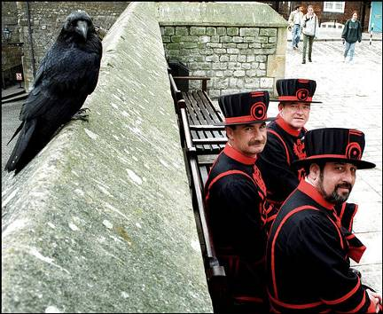
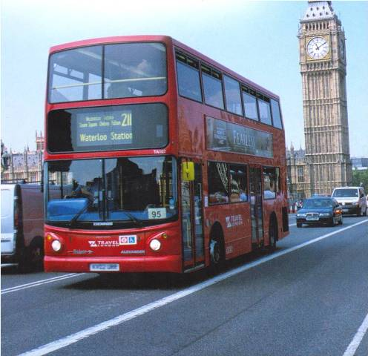
Other Symbols of England
Tower of London,
Big Ben,
Buckingham Palace,
Queen Elizabeth II,
Tower Bridge,
ravens and beefeaters,
Shakespeare,
double-deca

Slide 7
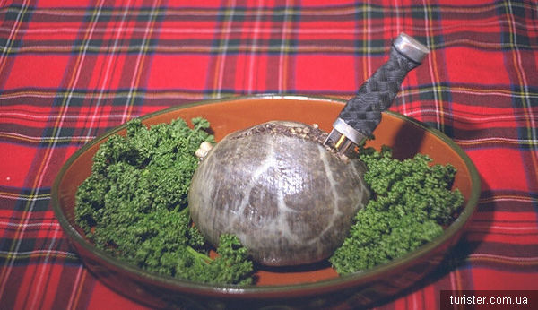
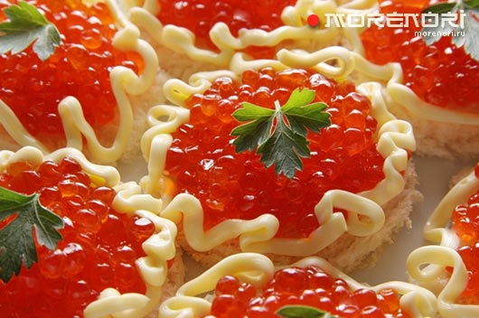
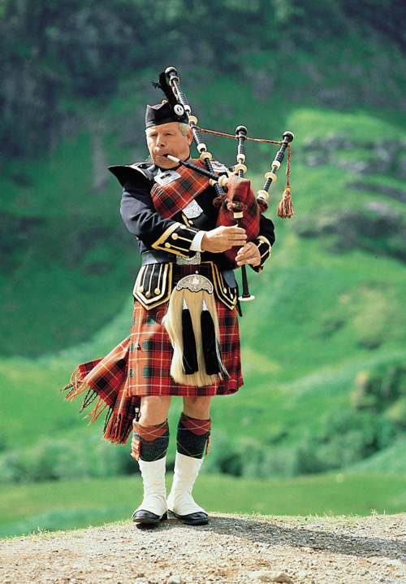
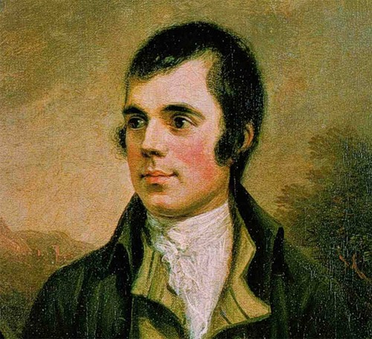
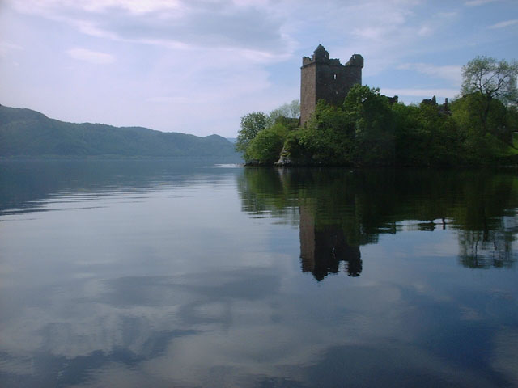
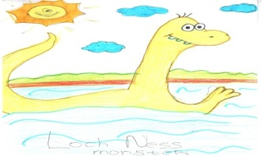
Other Symbols of Scotland
Haggis,
salmon, caviar,
tartan,
kilt,
bagpipe,
Robert Burns,
Lake Loch Ness,
Nessie

Slide 8
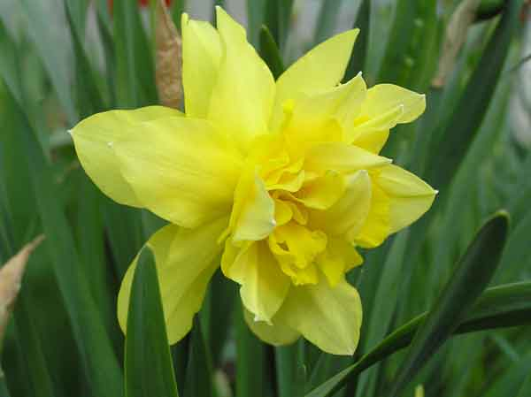
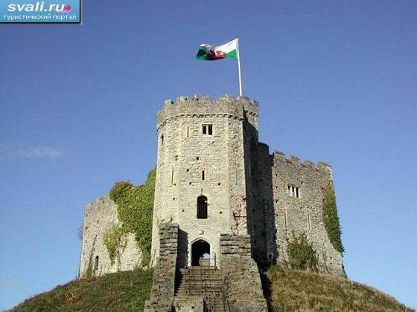
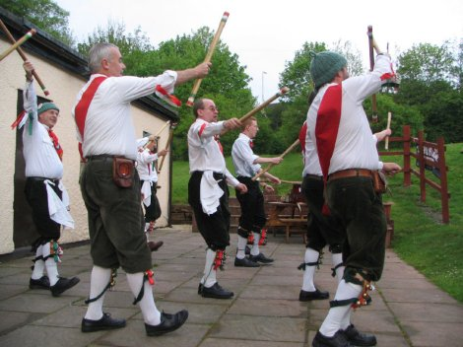
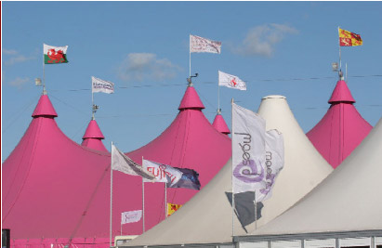
Other Symbols of Wales
Castles
Eisteddfod

Slide 9
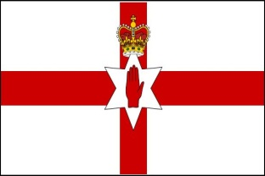
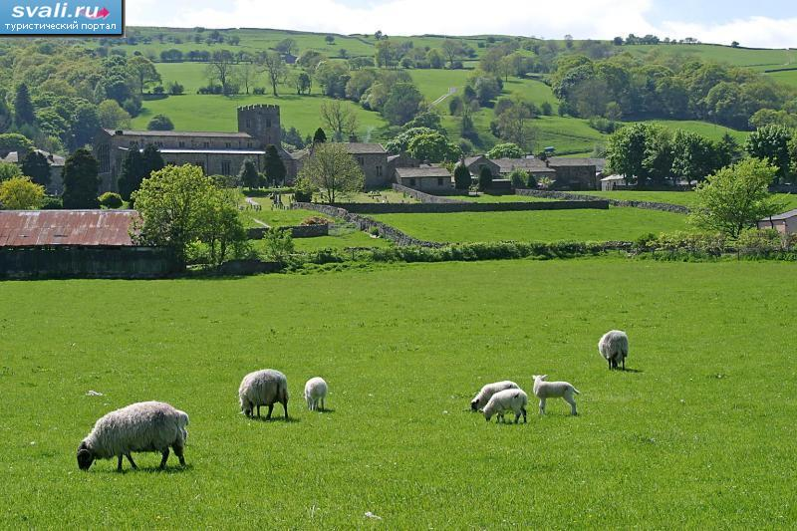
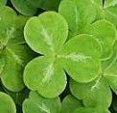
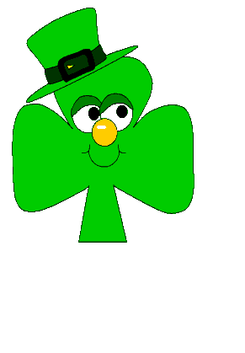
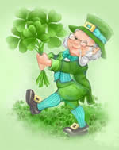
Other Symbols of Ireland
St. Partik’s Festival
Ireland is also called the Emerald Isle

Slide 11
Bobby’s Sculpture in Edinburgh
Bobby’s master was John Gray, who worked for the Edinburgh City Police as a night watchman.
They put Bobby’s sculpture a year later after his death, 1873.

Slide 12
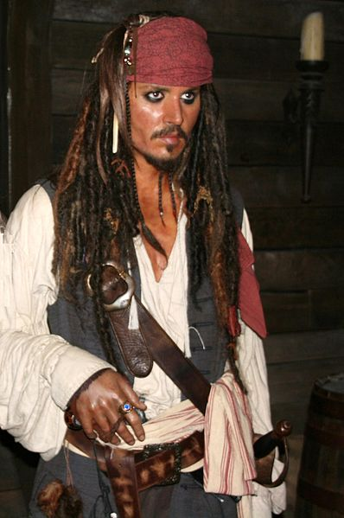
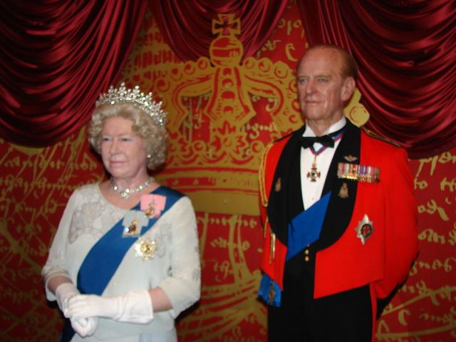
Madame Tussaud’s
Madame Tussaud’s real name was Anna Maria Grosholtz.
We can see wax figures of many world famous actors, pop-stars, politicians, members of the royal family (Johny Depp, Keira Knightley, Lady Gaga and others).

Slide 13
Museum of Nessie in Scotland

Slide 14
There are two letters, Е. R., on the front of Beefeaters' tunics. They stand for the Queen's name Elizabeth Regina. The uniform is as it used to be in Tudor times.‘

